Slide 1
Module 1
CSE3011 Reinforcement Learning
Credit Structure : 2-2-3

Slide 2
Module 1 : Introduction to RL
Topics : Elements of RL - Agent, environment Interface, Goals and rewards, RL platforms, Applications of RL, Markov decision process (MDP), RL environment as a MDP, Maths essentials of RL, Policy and its types, episodic and continuous tasks, return and discount factor, fundamental functions of RL – value and Q functions, model-based and model-free learning, types of RL environments, Solving MDP using Bellman Equation, Algorithms for optimal policy using Dynamic Programming -Value iteration and policy iteration, Example : Frozen Lake problem, Limitations and Scope.

Slide 3
Introduction to RL
Reinforcement Learning(RL) is one of the areas of Machine Learning(ML).
It is a feedback-based Machine learning technique in which an agent learns to behave in an environment by performing the actions and seeing the results of actions.
For each good action, the agent gets positive feedback, and for each bad action, the agent gets negative feedback or penalty.
The agent interacts with the environment and explores it by itself. The primary goal of an agent in reinforcement learning is to improve the performance by getting the maximum positive rewards.
It is one of the most active research areas in AI.
It has evolved and capable of building a recommendation system to self-driving cars.
Reason for this evolution is deep RL, a combination of DL and RL.
https://neptune.ai/blog/reinforcement-learning-applications

Slide 4
Introduction to RL..
In Reinforcement Learning, the agent learns automatically using feedbacks without any labeled data, unlike supervised learning.
Since there is no labeled data, the agent is bound to learn by its experience only.
RL solves a specific type of problem where decision making is sequential, and the goal is long-term, such as game-playing, robotics, etc.

Slide 5
RL agents
The goal of reinforcement learning is to train an agent to complete a task within an uncertain environment.
At each time interval, the agent receives observations and a reward from the environment and sends an action to the environment.
The reward is a measure of how successful the previous action (taken from the previous state) was with respect to completing the task goal.

Slide 6
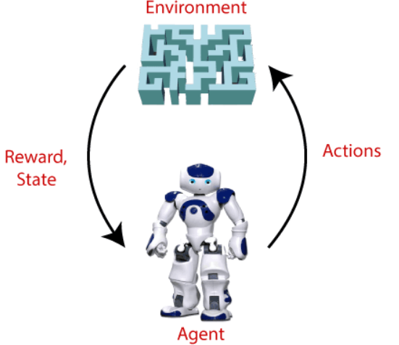
Example
Goal of an AI agent has to find the diamond present within a maze environment
The agent interacts with the environment by performing some actions, and based on those actions, the state of the agent gets changed, and it also receives a reward or penalty as feedback for its actions.
The agent continues doing these three things
(take action, change state/remain in the same state, and
get feedback), and by doing these actions, he learns and
explores the environment.
The agent learns that what actions lead to positive feedback
or rewards and what actions lead to negative feedback penalty.
As a positive reward, the agent gets a positive point, and as a
penalty, it gets a negative point.

Slide 7
Elements of RL
LO1: Define the key elements of RL
LO2: Explain the steps involved in a typical RL algorithm
LO3: Differentiate the three machine learning paradigms namely, supervised, unsupervised and reinforcement learning.

Slide 8
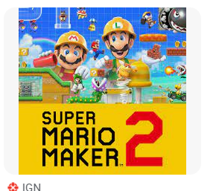
Elements of RL
1. Agent:
It is a software that learns to make intelligent decisions.
In an RL setting, an agent is a learner.
Ex1: a chess-player is an agent, the player learns to make the best moves (decisions) to win the game.
Ex2 : Mario in a Super Mario Bros Video Game

Slide 9
Elements of RL
2. Environment :
It is the world of the agent, within which the agent stays, takes actions and interacts.
Ex1: chess-board in a chess game.
The chess player(agent) stays in the chess board to learn how to play the game.

Slide 10
Elements of RL
3. State and Action:
In an RL setup, the environment has many positions where the agent can be in.
Each such position is a state.
A state is denoted by s
Ex: in a chess-board environment, each position is a state.

Slide 11
Elements of RL
3. State and Action:
The agent interacts with the environment and moves from one state to another state by performing an action.
Ex: In a chess-game environment, the action is the move performed by the player(agent).
An action is denoted by a

Slide 12
Elements of RL
4. Reward :
The agent interacts with the environment by performing an action and moves from one state to another.
Based on the action the agent receives a reward.
Reward is a numerical value, ex: +1 for a good action, -1 for a bad action.
Ex: in a chess-game, good action – the agent’s move which takes one of the opponent’s chess piece; bad action – the agent’s move loosing one chess piece to the opponent

Slide 13
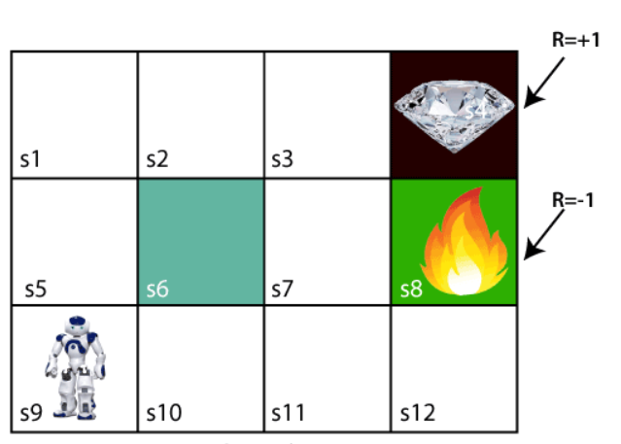
Basic idea of RL
To understand the working process of the RL, we need to consider two main things:
Environment: It can be anything such as a room, maze, football ground, etc.
Agent: An intelligent agent such as AI robot.
Let's take an example of a maze environment that the goal of the agent is to explore and find the path to the diamond in few steps.
States : S1 to S12, where S6 is a wall, S8 is a
fire pit and S4 has diamond.
Actions : move left, right, up and down

Slide 14
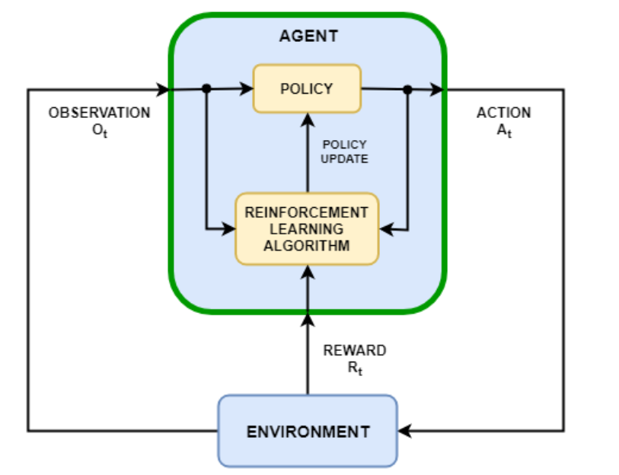
A typical RL setup
The agent has two components : policy and the RL algorithm.
Policy :
It is a mapping from the current environment’s observation to a probability distribution of the actions to be taken.
Within an agent, the policy is implemented by a function approximator with tunable parameters and a specific approximation model, such as a deep neural network.
RL algorithm:
The learning algorithm continuously updates the policy parameters based on the actions, observations, and rewards.
The goal of the learning algorithm is to find an optimal policy that maximizes the expected cumulative long-term reward received during the task.

Slide 15
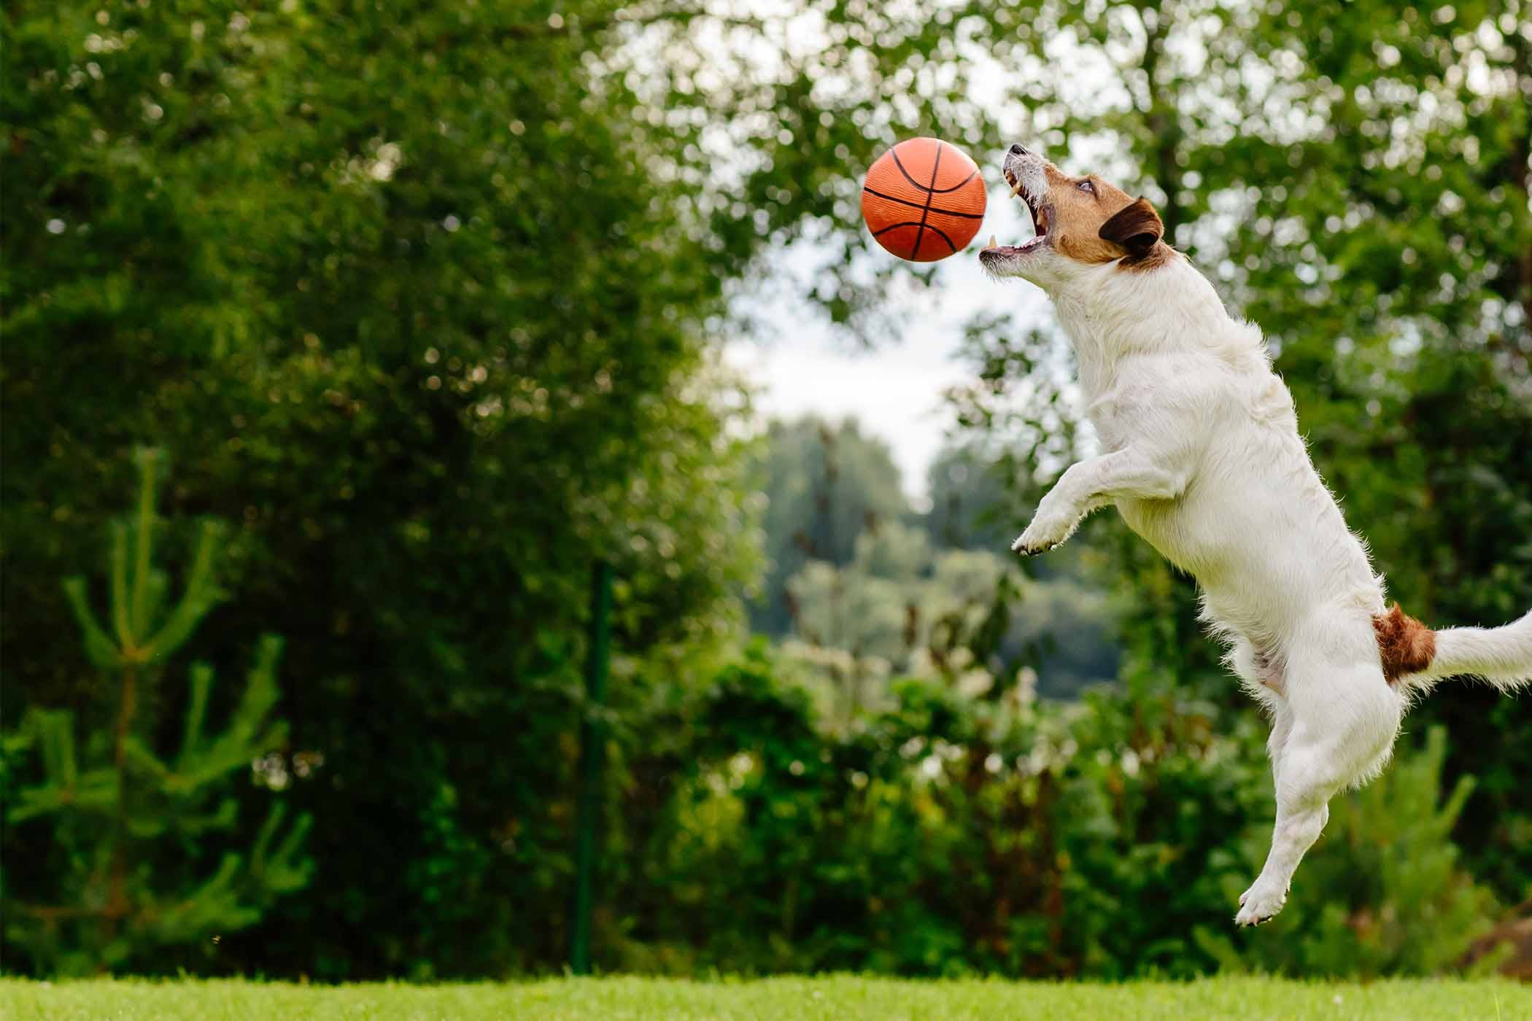
How RL differs from other ML paradigms?
Task : train a dog to catch a ball
Difference between RL and Supervised learning:
Supervised learning, we train the dog explicitly
with training data : turn left, go right, move forward seven steps, catch the ball and so on.
In RL, we simply throw the ball, every time the dog catches the ball, we give it a cookie(reward).
So the dog will learn to catch the ball while trying to maximize the cookies(rewards) it can get.

Slide 16
How RL differs from other ML paradigms?
Difference between RL and unsupervised learning?
Task : Movie recommendation system- recommend a new movie to the user
Unsupervised learning: the model will recommend a new movie based on the similar movies the user has viewed before.
In RL, each time the user watches a movie, the agent receives feedback from the user.
Feedbacks are rewards(ratings given by the user to this movie, time spent watching the movie, etc).
Based on these rewards, the RL agent will understand the movie preference of the user, then suggests new movies accordingly.

Slide 17
How RL differs from other ML paradigms?
Hence, the supervised and unsupervised the models learn from the training data set.
In RL, the agent learns by continuously interacting with the environment.
Hence entire RL is about the interaction between the agent and the environment.

Slide 18
A typical RL algorithm
The steps involved in a typical RL algorithm are:
First, the agent interacts with the environment by performing an action.
By performing an action, the agent moves from one state to another.
Then the agent will receive a reward based on the action it performed.
Based on the reward, the agent will understand whether the action is good or bad.
If the action was good, that is, if the agent received a positive reward, then the agent will prefer performing that action, else the agent will try performing other actions in search of a positive reward.
The goal of the agent is to maximize the reward it gets. If the agent receives a good reward, then it means it has performed a good action. If the agent performs a good action, then it implies that it can win the game. Thus, the agent learns to win the game by maximizing the reward

Slide 19
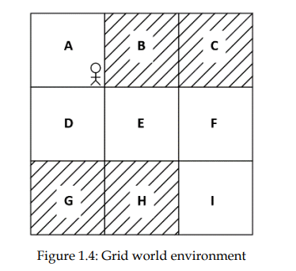
RL agent in the grid world environment
Environment : Grid World environment
States : A,B,C,D,E,F,G,H and I. Shaded states are hole states.
Goal of the agent : reach state I from state A.
Actions : move up, down, left and right.
Every time the agent reaches one of the shaded states it receives a negative reward(-1).
Every time the agent reaches one of the unshaded states it receives a positive reward(+1).
First time when the agent interacts with the envt (first iteration), it performs a random action in each state, and mostly ends up with negative rewards.
But, over a series of iterations, it learns to perform the correct action in each state, based on the rewards it has obtained in that state in the previous iterations and hence reaches the goal.

Slide 20
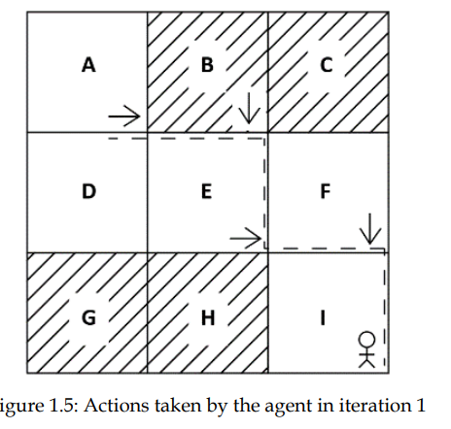
RL agent in the Grid World Environment
Iteration 1:

Slide 21
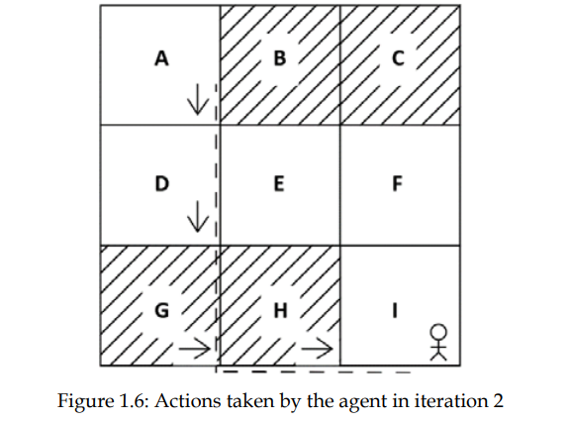
RL agent in the Grid World Environment
Iteration 2:

Slide 22
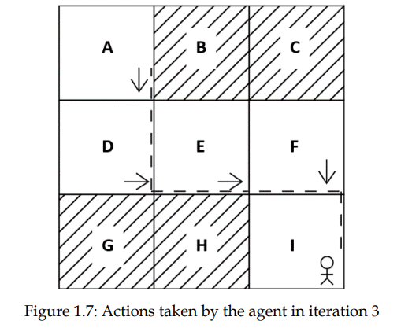
RL agent in the Grid World Environment
Iteration 3:

Slide 23
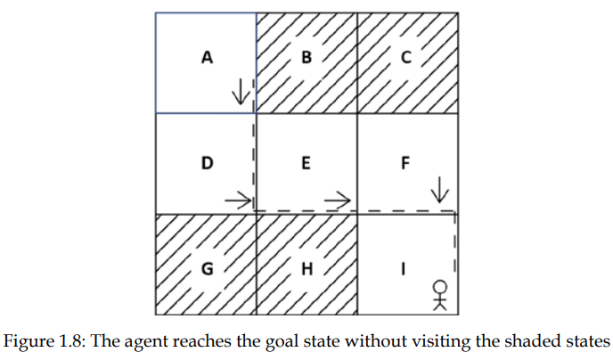
RL agent in the Grid World Environment
Result of Iteration 3, the agent reaches the goal state without reaching the shaded states.
The agent has successfully learnt to reach the goal state I from state A, without visiting the shaded states based on the rewards.
The goal of the agent is to maximize the rewards and
ultimately achieve the goal
Each iteration known as an episode in RL terms.

Slide 24
Types of RL environments
LO1: List the types of RL environments
LO2: Differentiate the different types of RL environments
LO3: Explain the different types of RL environments with an example

Slide 25
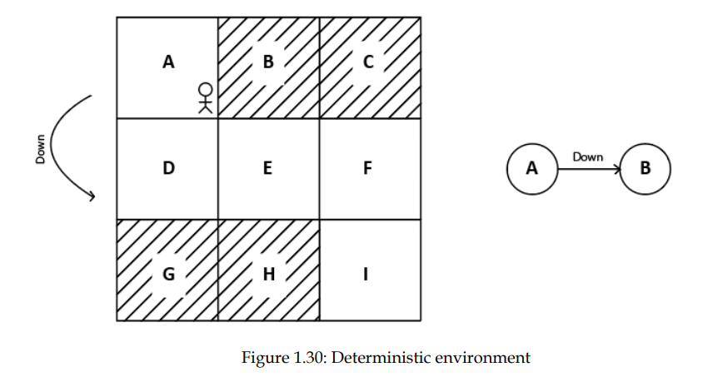
Types of RL environments
Deterministic environment : It is certain that, when an agent in state s, performs an action a, then it always reaches state s’.
Ex: Chess – there would be only a few possible moves for a coin at the current state and these moves can be determined.

Slide 26
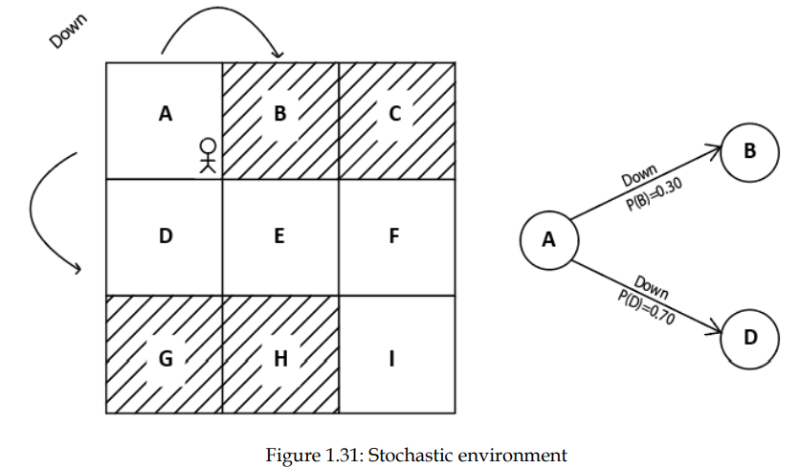
Types of RL environments
Stochastic environment : When an agent in state s, performs an action a, then we cannot say that, it always reaches state s’.
We cannot determine the outcome of the action in the current state
This is due to the randomness in the stochastic environment.
Ex1: Self-Driving Cars- the actions of a self-driving car are not unique, it varies time to time.
Ex2: The radio station is a stochastic environment where the listener is not aware about the next song.

Slide 27
Types of RL environments
3. Discrete Environment: The action space of the environment is discrete.
Ex: action space of the grid world environment is [up, down, left, right].
4. Continuous environment: The action space of the environment is continuous
Ex1: To train an agent to drive a car, then the action space will involve multiple actions like [changing the car’s speed, the no. of degrees to rotate the wheel, etc..]
Ex2: In a basketball game, the position of players (Environment) keeps changing continuously and hitting (Action) the ball towards the basket can have different angles and speed so infinite possibilities.

Slide 28
Types of RL environments
5. Episodic/Non-Sequential Environment: the agent’s current action will not affect the future actions
Ex: A support bot (agent) answering to a question and then answering to another question and so on. So each question-answer is a single episode.
6. Non-Episodic/Sequential Envt: the agent’s current action will affect its future actions.
Ex: a chess-board is a sequential environment since the agent’s current action will affect its future actions in a chess match.

Slide 29
7. Single and Multi-agent environments:
Single agent environment where an environment is explored by a single agent. All actions are performed by a single agent in the environment.
Real-life Example: Playing tennis against the ball is a single agent environment where there is only one player.
If two or more agents are taking actions in the environment, it is known as a multi-agent environment.
Real-life Example: Playing a soccer match is a multi-agent environment.

Slide 30
Markov decision process (MDP)
LO1: State the Markov property, Markov chain, Markov reward process and the Markov decision process.
LO2: Explain the Markov chain with a suitable example
LO3: Recognize the mathematical essentials of RL
LO4: Interpret the grid world RL environment as a MDP

Slide 31
Markov Decision Process(MDP)
MDP is mainly used to study optimization problems via dynamic programming.
A Markov decision process (MDP) refers to a stochastic decision-making process that uses a mathematical framework to model the decision-making of a dynamic system.
It is used in scenarios where the results are either random or controlled by a decision maker, which makes sequential decisions over time.
MDPs evaluate which actions the decision maker should take considering the current state and environment of the system.
Almost all RL problems can be modelled as a MDP.
In artificial intelligence, MDPs model sequential decision-making scenarios with probabilistic dynamics.
They are used to design intelligent machines or agents that need to function longer in an environment where actions can yield uncertain results.

Slide 32
MDP
MDP uses two entities namely Markov property and Markov chain.
Markov property : says the future depends only on the present and not on the past.
Markov chain/Markov process : has a sequence of states that strictly obey the Markov property.
Markov chain is a probabilistic model that solely depends on the current state to predict the next state and not the previous states.
The future is conditionally independent of the past.
Ex : if the current state of weather is cloudy, we can predict the next state to be rainy.
We made this prediction only based on the current state(cloudy) and not on the previous states which might be sunny, windy, etc.
Markov property is not valid for all processes.
Ex: while throwing a dice(the next state), doesn’t depend on the previous number that showed up on the dice(the current state)

Slide 33
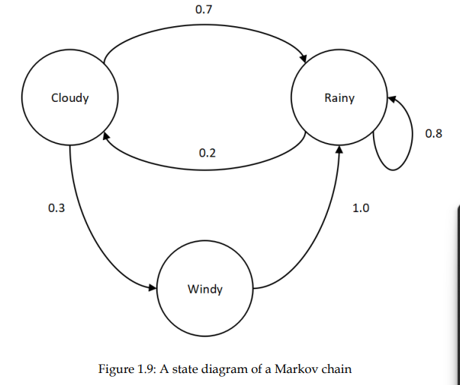
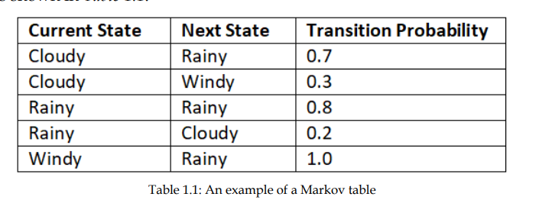
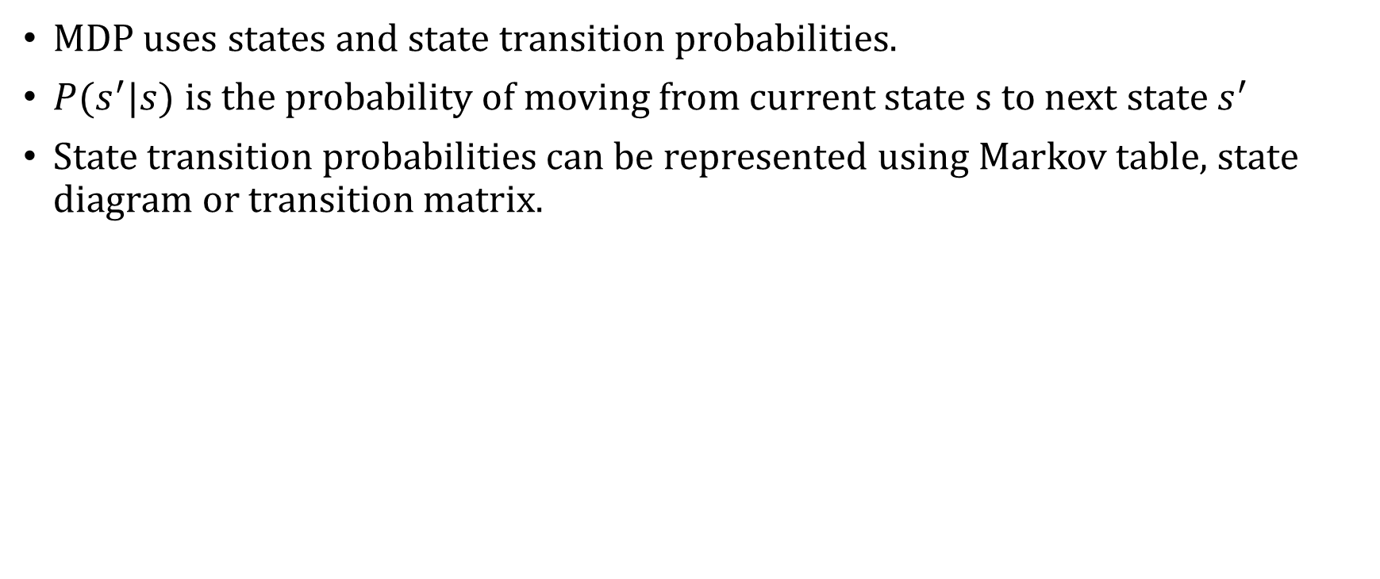
MDP
MDP uses states and state transition probabilities.
$P(s^{′}|s)$is the probability of moving from current state s to next state $s^{′}$
State transition probabilities can be represented using Markov table, state diagram or transition matrix.

Slide 34
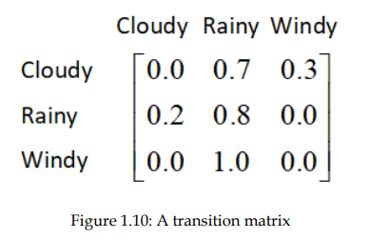
Hence, a Markov process consists of a set of states along with their transition probabilities

Slide 35
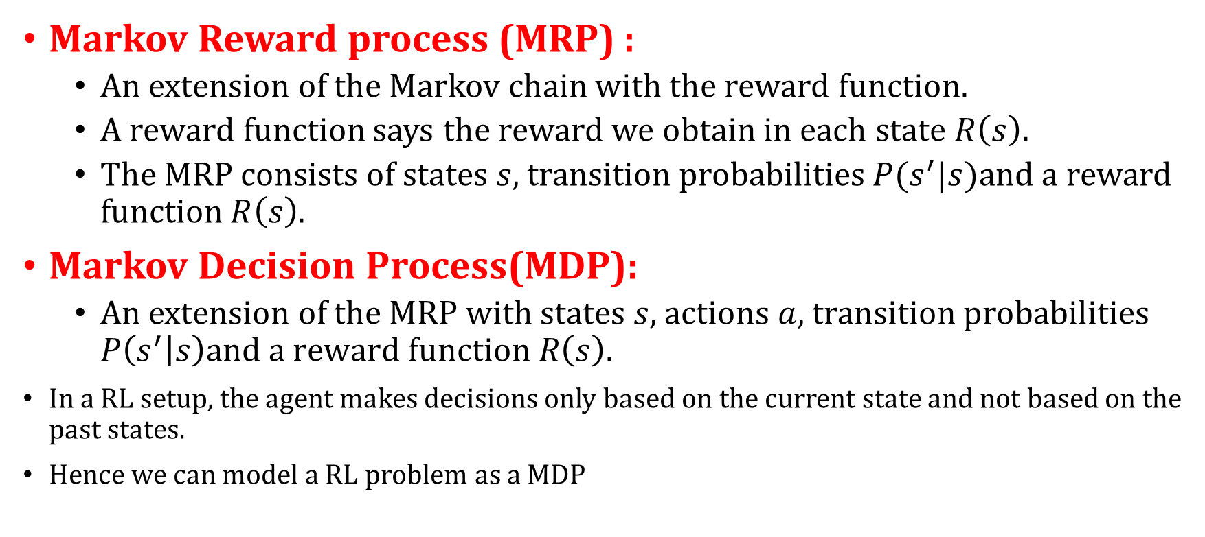
MDP…
Markov Reward process (MRP) :
An extension of the Markov chain with the reward function.
A reward function says the reward we obtain in each state $R\left(s\right).$
The MRP consists of states $s$, transition probabilities $P(s^{′}|s)$and a reward function $R\left(s\right)$.
Markov Decision Process(MDP):
An extension of the MRP with states $s$, actions $a,$transition probabilities $P\left(s^{′} | s\right)\text{and} \text{a} \text{reward} \text{function} R\left(s\right)\text{.}$
In a RL setup, the agent makes decisions only based on the current state and not based on the past states.
Hence we can model a RL problem as a MDP

Slide 36
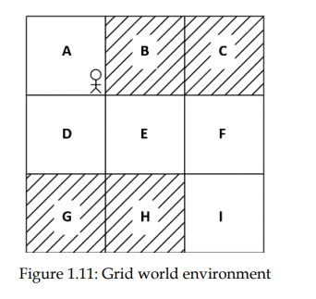
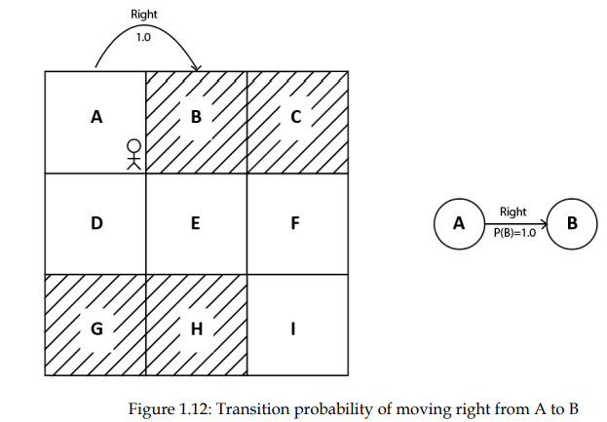
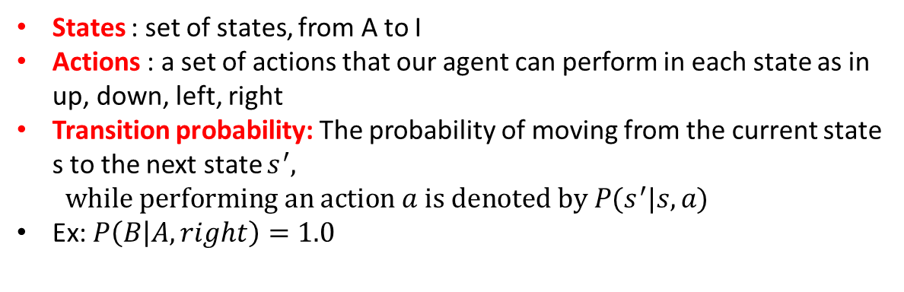
Grid World as MDP
Goal : the agent has to move from state A to state I, without visiting the shaded states.
States : set of states, from A to I
Actions : a set of actions that our agent can perform in each state as in up, down, left, right
Transition probability: The probability of moving from the current state s to the next state $s^{′}, while performing an action a is denoted by P(s^{′}|s,a)$
Ex: $P\left(B | A, right\right)=1.0$

Slide 37
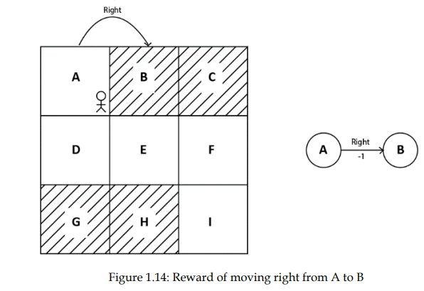
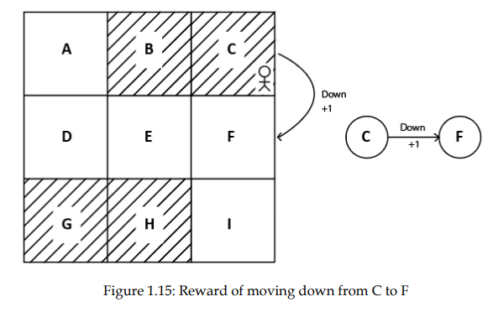
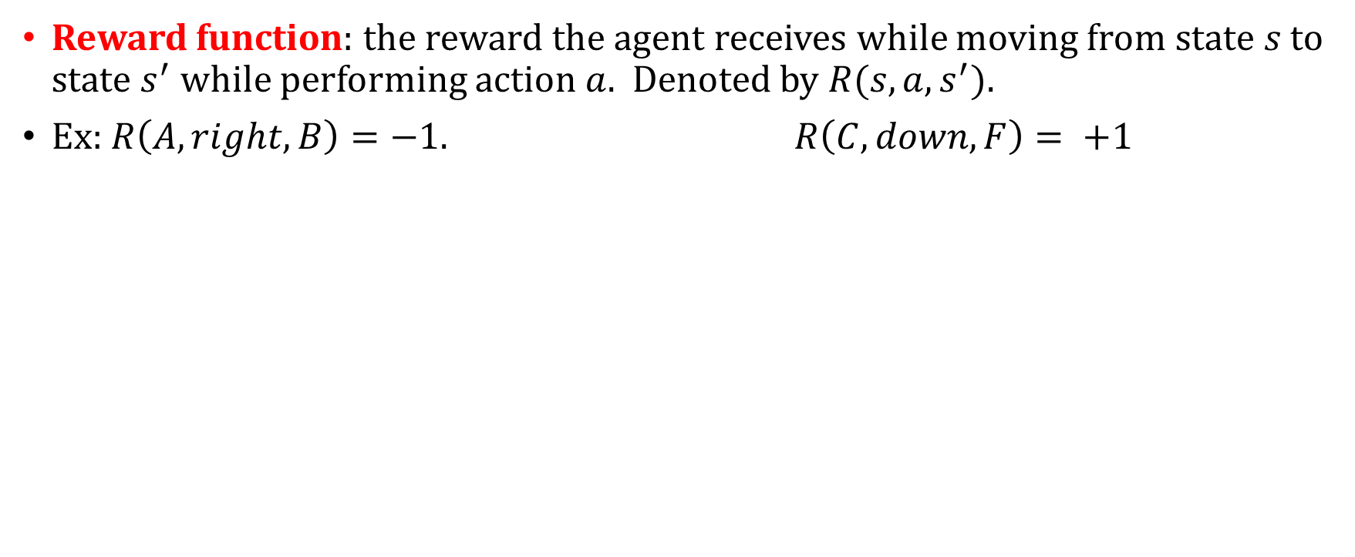
Grid World as MDP
Reward function: the reward the agent receives while moving from state $s$ to state $s^{′}$ while performing action $a.$ Denoted by $R(s,a,s^{′})$.
Ex: $R\left(A, right, B\right)=−1$. $R\left(C, down, F\right)= +1$

Slide 38
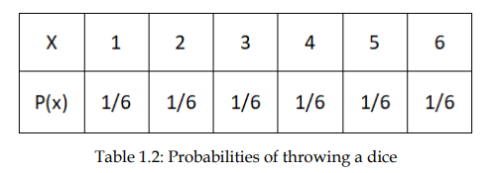
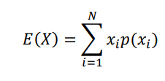
Fundamental concepts of RL
Maths essentials : Expectation of a random variable X
A random variable takes values from a random experiment such as throwing a dice, tossing a coin, etc.
Ex : if we are throwing a fair dice, then the possible outcomes(X) are 1,2,3,4,5,and 6.
The probability of occurrence of each of these outcomes are 1/6
Find the average value of the random variable X?
Ans : take the weighted average of X

Slide 39
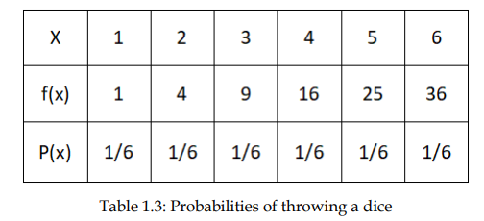
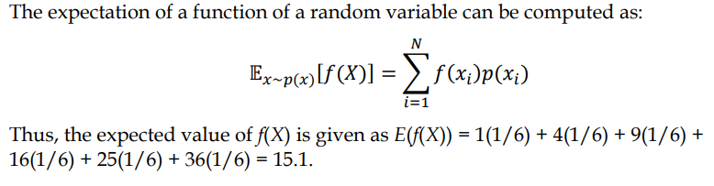
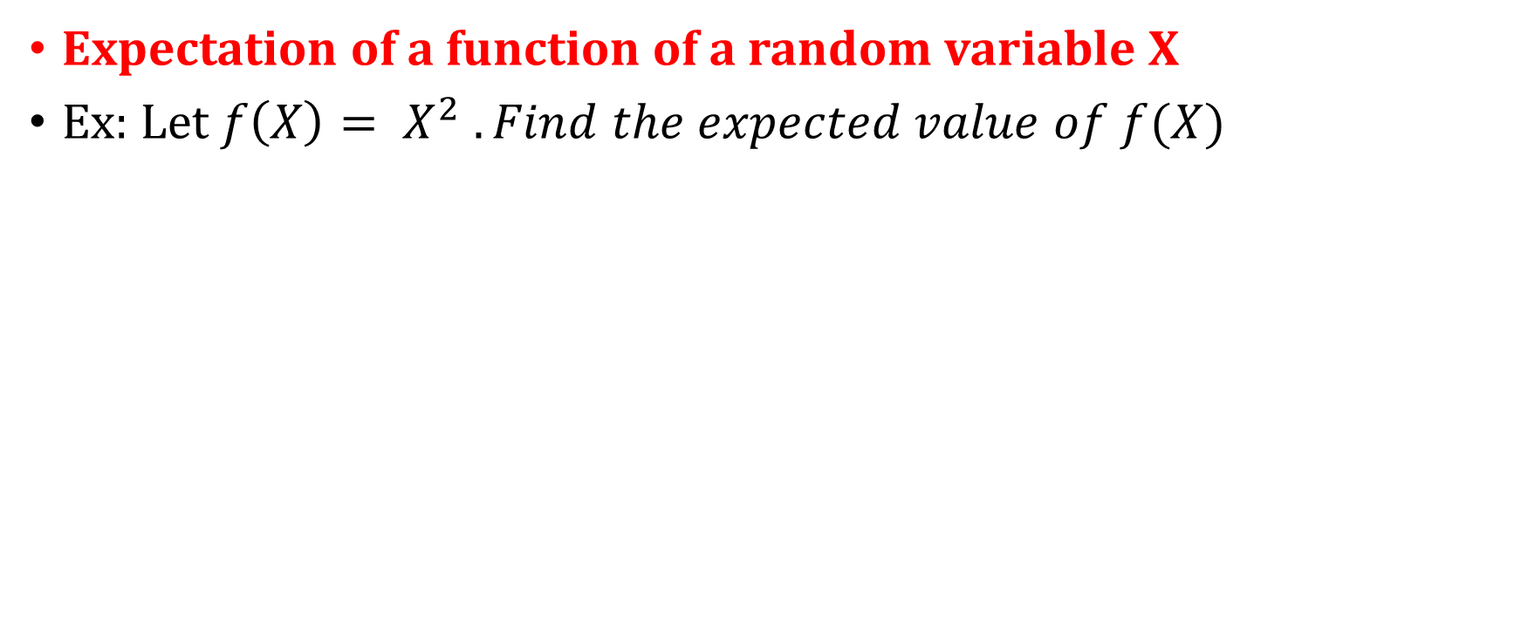
Fundamental concepts of RL
Expectation of a function of a random variable X
Ex: Let $f\left(X\right)= X^{2} . Find the expected value of f(X)$

Slide 40
Fundamental concepts of RL
Action Space : the set of all possible actions in the environment
Ex: for the grid world environment, the action space is [up,down,left,right]
Types of Action Space: discrete and continuous
A Discrete action space has actions that are discrete.
Ex: the action space of the grid world environment
A continuous action space has action that are continuous.
Ex: training an agent to drive a car, actions are continuous in nature such as speed, degrees to rotate the wheel, etc..

Slide 41
Fundamental concepts of RL
A policy defines the agent’s behaviour in an environment.
It tells the agent what action to perform in each state.
Ex: in the grid world envt with states from A to I, and 4 actions, a policy may tell the agent to move down in state A, move right in state D, so on.
In the first iteration, the agent starts with a random policy, taking a random action in each state.
Learns whether the actions taken in each state are good or bad based on the reward it gets.
Over a series of iterations, the agent learns a good policy that gets a positive reward.
This good(optimal) policy is the policy that gets the agent a good reward and helps the agent to reach the goal state.

Slide 42
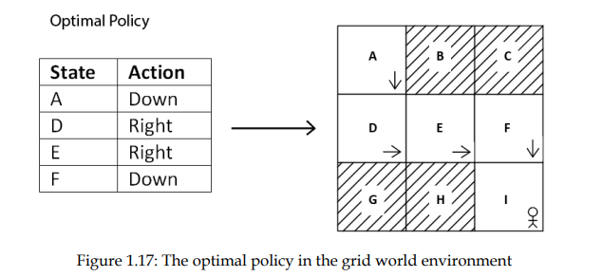
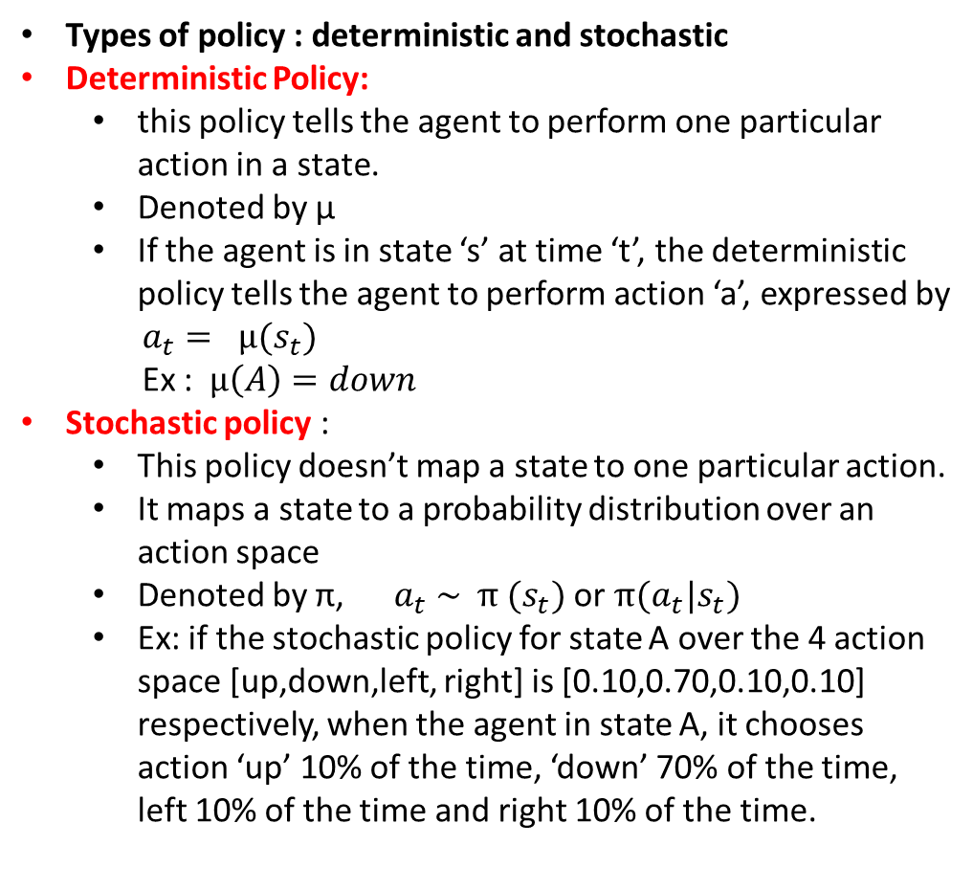
Fundamental concepts of RL..
Types of policy : deterministic and stochastic
Deterministic Policy:
this policy tells the agent to perform one particular action in a state.
Denoted by μ
If the agent is in state ‘s’ at time ‘t’, the deterministic policy tells the agent to perform action ‘a’, expressed by
$a_{t}= μ(s_{t})$
Ex : $μ\left(A\right)=down$
Stochastic policy :
This policy doesn’t map a state to one particular action.
It maps a state to a probability distribution over an action space
Denoted by π, $a_{t} \sim π (s_{t})$ or $π(a_{t}|s_{t})$
Ex: if the stochastic policy for state A over the 4 action space [up,down,left, right] is [0.10,0.70,0.10,0.10] respectively, when the agent in state A, it chooses action ‘up’ 10% of the time, ‘down’ 70% of the time, left 10% of the time and right 10% of the time.
Ex of an optimal policy

Slide 43
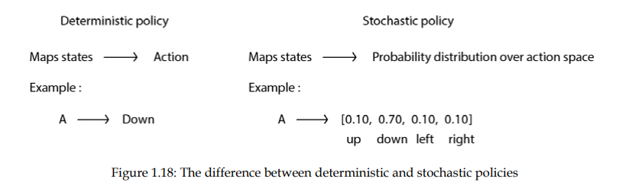
Fundamental concepts of RL..

Slide 44
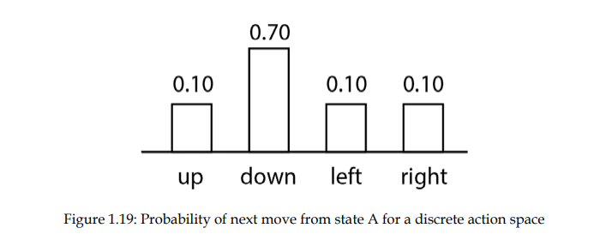
Types of Stochastic policy : Categorical and Gaussian
Categorical policy:
If the action space of a stochastic policy is discrete,
then it is a categorical policy
Prob distributions are taken over a discrete action space

Slide 45
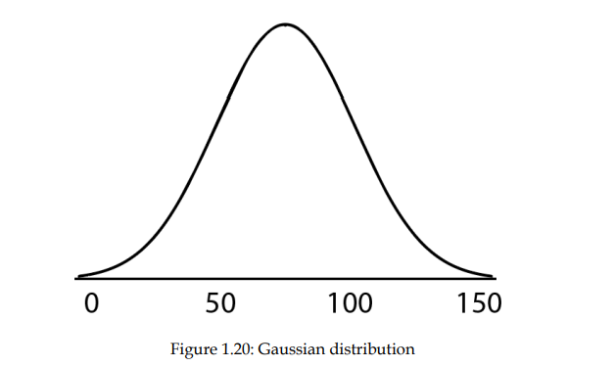
Gaussian policy
A stochastic policy whose action space is continuous
Its uses a Gaussian prob distribution over an action space
Ex: if we are training an agent to drive a car, there is a continuous action in our action space – speed of the car whose value ranges from 0 to 150kmph.
The stochastic policy uses the Gaussian distribution over the action space to select an action

Slide 46
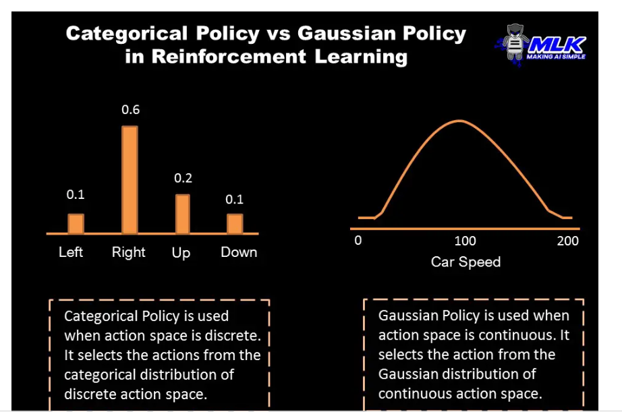

Slide 47
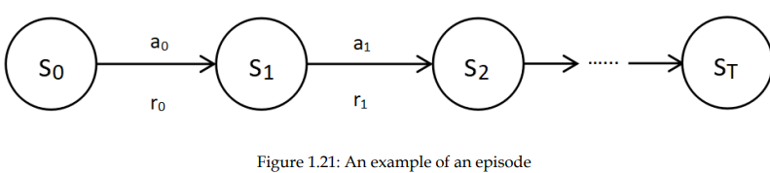
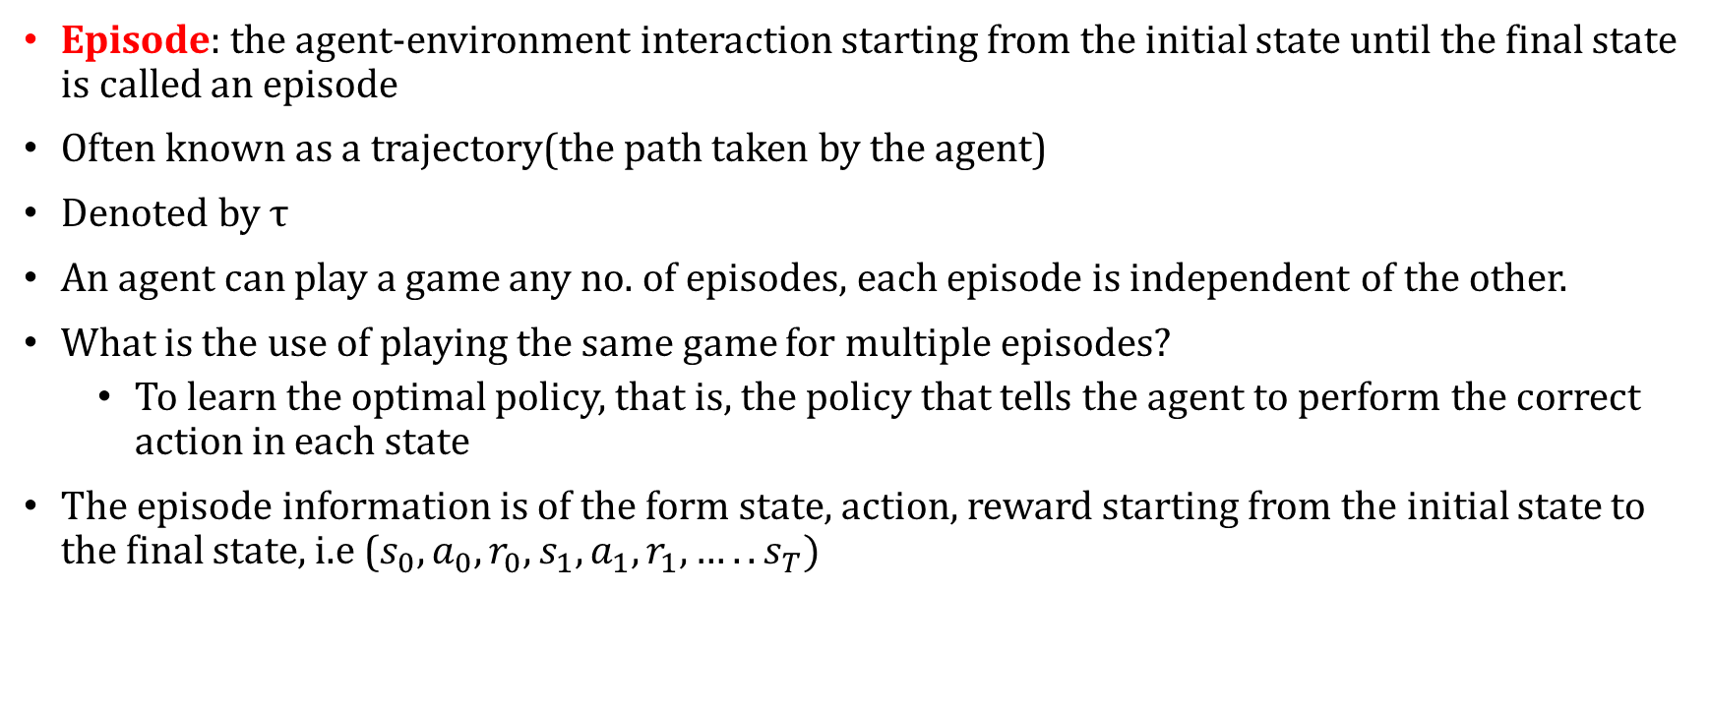
Episode: the agent-environment interaction starting from the initial state until the final state is called an episode
Often known as a trajectory(the path taken by the agent)
Denoted by τ
An agent can play a game any no. of episodes, each episode is independent of the other.
What is the use of playing the same game for multiple episodes?
To learn the optimal policy, that is, the policy that tells the agent to perform the correct action in each state
The episode information is of the form state, action, reward starting from the initial state to the final state, i.e ($s_{0}, a_{0}, r_{0}, s_{1}, a_{1}, r_{1}, …..s_{T})$

Slide 48
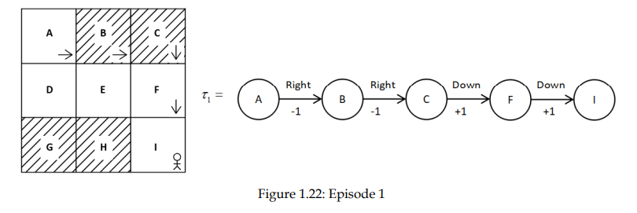
Episode and optimal policy in Grid world Envt
The agent generates the first episode using a random policy
Explores the envt over several episodes to learn an optimal policy
Episode 1

Slide 49
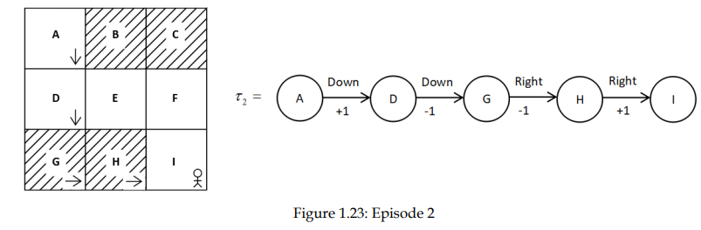
Episode 2 : the agent tries a different policy to avoid the negative rewards it got in the previous episode

Slide 50
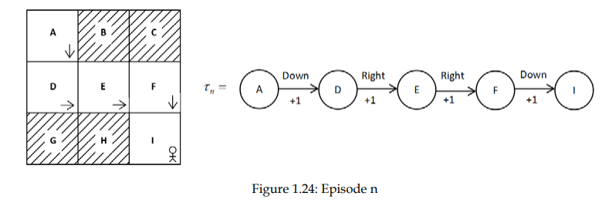
Episode n: Over a series of episodes, the agent learns the optimal policy, the policy that takes the agent from state A to state I, without visiting the shaded states and also maximising the rewards.

Slide 51
Episodic and continuous tasks
Episodic tasks: a task made up of episodes and thus they have a terminal state
Ex: car racing game
Continuous tasks: do not have any episodes and so don’t have any terminal state.
Ex: a personal assistance robot does not have a terminal state
Horizon : the time step until which the agent interacts with the envt.
Types : finite and infinite horizon
Finite horizon : the agent-envt interaction stops at a particular time step.
Ex: in an episodic task, the agent-envt interaction stops after the agent reaches the final state T.
Infinite horizon: the agent-envt interaction never stops
Ex: a continuous task without final state has an infinite horizon.

Slide 52
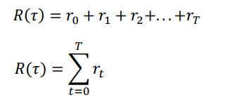
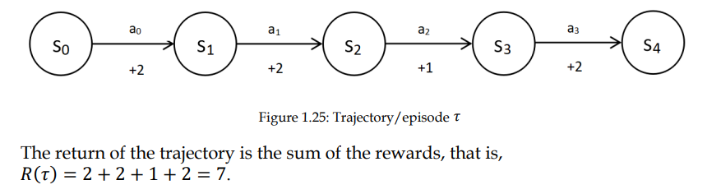
Return and discount factor
Return : sum of the rewards obtained by an agent in an episode.
Denoted by R or G.
Ex: if the agent starts at initial state at time step t=0 and reaches the final state at time step T, then the return by the agent is
Ex: for the trajectory below:

Slide 53
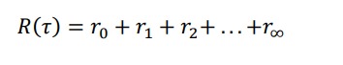
Return and discount factor..
So the goal of the agent is to maximise the return, i.e, maximise the sum of the rewards obtained over an episode.
How can we maximise this return? How can we perform the correct action in each state?
By using the optimal policy – the policy that gets our agent the maximum return (sum of the rewards) by performing the correct action in each state.
How to define return for continuous tasks, where there is no terminal state?
Return for continuous tasks – sum of the rewards upto infinity.

Slide 54
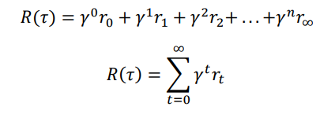
Return and discount factor..
How to maximise the return that sums to infinity?
Using discount factor
Discount factor helps us by preventing the return in reaching infinity, by deciding how much importance we should give to immediate rewards and future rewards.
Its value ranges from 0 to 1

Slide 55
Return and discount factor..
If the discount factor is too small(close to 0), it means we give more importance to immediate rewards than future rewards.
If the discount factor is set to a large value(close to 1), it means we give more importance to future rewards than immediate rewards.

Slide 56
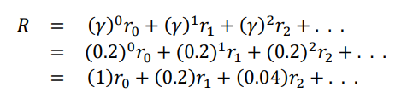
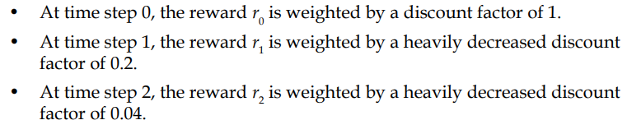
Return and discount factor..
What happens when the discount factor is small? γ = 0.2?
So, when we set discount factor to a small value, we give more importance to immediate rewards than future rewards.

Slide 57
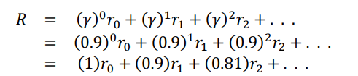
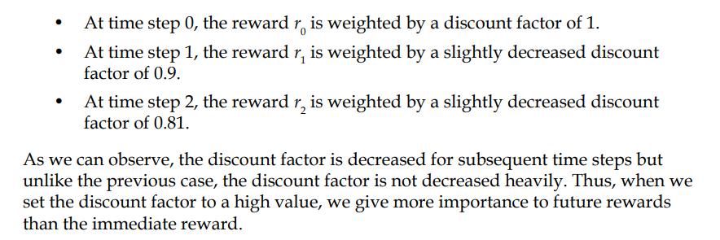
Return and discount factor..
What happens when the discount factor is large? γ = 0.9?

Slide 58
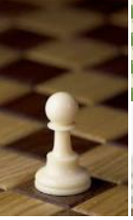
Immediate or future rewards?
It depends on the task that we want to train an agent for.
Suppose, in a chess game, the goal is to defeat the opponent’s king.
If we give importance to the immediate rewards like a reward on pawn defeat any opponent player then the agent will learn to perform these sub-goals no matter if his players are also defeated.
So, in this task future rewards are more important

Slide 59
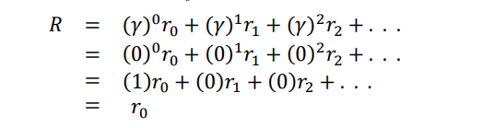
Return and discount factor..
What happens when the discount factor is set to 0? γ = 0?
Our return is just the immediate reward

Slide 60
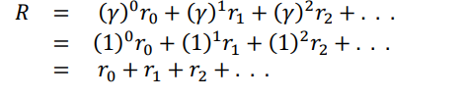
Return and discount factor..
What happens when the discount factor is set to 1? γ = 1?
Our return is just the sum of the rewards upto infinity

Slide 61
Return and discount factor..
If the discount factor is set to 0, the agent never learns, as it considers only the immediate reward.
If the discount factor is set to 1, the agent will learn forever, looking for the future rewards that lead to infinity.
So, the optimal value of discount factor is between 0.2 to 0.8
For certain tasks future rewards are more important than immediate rewards and vice versa.

Slide 62

Value function
Value function also called the state value function gives the value of a state.
The value of a state ‘s’ is the return of the trajectory τ starting from that state to the final state following a policy π.
The policy could be deterministic or stochastic
A deterministic policy maps each state to a one particular action
A stochastic policy selects action for a state based on a probability distribution of the action space.

Slide 63

Value function for a deterministic policy
If the trajectory τ, for the grid world environment, using some policy deterministic policy π is :

Slide 64

Value function for a deterministic policy…
The value function can be calculated for each state as the return(sum of the rewards) of the trajectory starting from that state :
The value function of the finals state is zero, since a reward is associated only with a state that has a transition.

Slide 65

Value function for stochastic policy
(Expected)value function of a state with a stochastic policy is the expected return that the agent would get starting from that state s and following a stochastic policy π.
Return of a state in a trajectory τ, following a stochastic policy π, is a random variable.
It takes different values with some probability in each trajectory.
It is expressed as :

Slide 66
Value function for stochastic policy…
Ex: In state A, the stochastic policy gives a prob distribution over the action space [up,down,left,right] as [0.0, 0.8, 0.0, 0.2], i.e
perform the action down 80% of the time, that is, 𝜋(down|𝐴) = 0.8, and the action right 20% of the time, that is 𝜋(right|𝐴) = 0.20
This gives two trajectories from state A.
Assume the stochastic policy selects “right” in states D and E and “down” in B and F 100% of the time.

Slide 67
𝜋(down|𝐴) = 0.8 𝜋(right|𝐴) = 0.20
𝜋(right|D) = 1 𝜋(right|E) = 1
𝜋(down|B) = 1 𝜋(down|F) = 1

Slide 68


Value function for stochastic policy…
The first trajectory $τ_{1} with \text{π}\text{(}\text{down}\text{|}\text{A}\text{) = 0.8}$is :
Value of state A is, the return(sum of the rewards) of the trajectory starting from state A.
Thus, 𝑉(𝐴) = 𝑅($τ_{1}$) =1+1+1+1=4.

Slide 69


Value function for stochastic policy…
The second trajectory $τ_{2} with \text{π}\text{(}\text{right}\text{|}\text{A}\text{) = 0.20}$ is :
Value of state A is, the return(sum of the rewards) of the trajectory $τ_{2}$ starting from state A.
Thus, 𝑉(𝐴) = 𝑅($τ_{2}$) =-1+1+1+1=2.
Also, it’s the same policy, V(A) differs with the trajectories.
For this policy, return is 4, 80% of the time and 2, for 20% of the time.

Slide 70


Value function for stochastic policy…
Value of a state for a stochastic policy is the expected return of the trajectory starting from that state.
Expected return is the weighted average, sum of the returns, multiplied by their probabilities.
So, V(A) is :

Slide 71


Value function for stochastic policy…
Thus, the value of a state is the expected return of the trajectory starting from that state.
Value function depends on the policy.
There can be many value functions for a state, according to different policies.
The optimal value function V*(s) is the maximum value of the state, among all its value functions
Ex: Text book Pg.33 . We can find the optimal state from a Value table.

Slide 72


Q function
Q function denotes the value of a state-action pair for a particular state, s.
It is the return that the agent will obtain starting from a state s, and performing an action a, following a policy π
It is also known as state-action value function
Ex: Given trajectory τ, :

Slide 73


Q function…
Find the q-function of A-down, D-right :
Ans 1:
Ans 2: ? 3
Since return is a random variable taking a different value with some probability, instead of taking the return directly, we take the expected return.

Slide 74


Q function….
Q function depends on the policy.
There will be Q values for a (s,a) pair depending on the policy.
The optimal policy for a (s,a) pair is :
The optimal policy 𝜋* is the policy that gives the maximum Q value for a (s,a).
Given a Q table, we can find the optimal policy 𝜋*

Slide 75
Model-based and model-free learning
Model-based learning : the agent learns the optimal policy by using the model dynamics of the environment.
Model dynamics of the environment is defined using
1. state transition probabilities and 2. reward function
Model-free learning : the agent tries to learns the optimal policy without using the model dynamics of the environment

Slide 76
Bellman Equation and Dynamic Programming
LO1: State the Bellman equation of the value function and Q function
LO2: Solve MDP using Bellman equation
LO3: Apply Bellman equation to find the value function of a state for a given deterministic environment

Slide 77
Bellman Equation and Dynamic Programming
In RL, the agent has to learn an optimal policy to perform a particular task
An optimal policy selects the correct action for an agent in each state, so that the agent can get the maximum return and achieve its goal.
Two classical RL algorithms – value and policy iteration, helps the agent to learn an optimal policy.
These algos are model based and use Dynamic Programming
Bellman equation is used in RL to find the optimal value function and optimal Q functions recursively.
These are then used to find the optimal policy

Slide 78
Bellman Equation?
Bellman equation?
Bellman optimality equation?
Relationship between value and Q function?
Dynamic Programming – value and policy iteration methods?
Solving the Frozen Lake problem using value and policy iteration methods.

Slide 79



Bellman equation for the value function
As per Bellman Equation, the value of a state is the sum of the immediate reward $R(s,a,s^{′})$and the discounted value of the next state $γV(s^{′})$.

Slide 80



Bellman equation for the value function
In a deterministic environment:
Ex: Given a trajectory τ using some policy π as :
Using Bellman equation find V($s_{2})?$
Ans: $V\left(s_{2}\right)=R\left(s_{2}, a_{2}, s_{3}\right)+ γV(s_{3})$
= $r_{2}+ γV(s_{3})$
Hence the Bellman equation of the value function for a deterministic environment associated with a policy π is :
Where the rhs term is known as Bellman backup

Slide 81

Bellman equation for the value function
In a stochastic environment:

Slide 82

Bellman equation for the value function
Modify the Bellman equation of the value function with expectations (weighted average)
Bellman backup multiplied with the transition probability of the next state.

Slide 83


Bellman equation for the value function
Ex: same trajectory, find V($s_{1})?$
Ans:
Hence the Bellman equation for the value function for a stochastic environment for a policy π is :

Slide 84

Bellman equation for the value function
What if the policy itself is stochastic? Instead of performing the same action in a state, we select an action based on the prob distbn over the action space.
Ex:

Slide 85


Bellman eqn for value function…
to include the stochasticity present in the environment in the Bellman equation, we took the expectation (the weighted average), that is, a sum of the Bellman backup multiplied by the corresponding transition probability of the next state. •
Similarly, to include the stochastic nature of the policy in the Bellman equation, we can use the expectation (the weighted average), that is, a sum of the Bellman backup multiplied by the corresponding probability of action.
Using expectations :

Slide 86

Bellman Eqn of the Q function
For deterministic envt : Bellman eqn of the Q function says that, the Q value of a state-action pair is a sum of the immediate reward and the discounted Q value of the next state-action pair :

Slide 87





Ex: Given a trajectory τ using some policy π, find the Q value of ($s_{2}, a_{2}).$
Ans:

Slide 88

Bellman Eqn of the Q function…
For stochastic environment: An agent in state ‘s’, performs an action ‘a’, then the next state is not always the same.
Bellman eqn of the Q function for a stochastic envt, uses the expectation (weighted average), that is, a sum of the Bellman backup multiplied by their corresponding transition probability of the next state.
The Bellman equation of the Q function is:

Slide 89



Bellman Eqn of the Q function…
With a stochastic policy, we cannot guarantee $a^{′}$in $s^{′}$
Final Bellman Equation for Q(s,a) using expectation is :

Slide 90


Bellman Optimality Theorem
Gives the optimal Bellman value and Q function
V(s) depends on the policy .
The optimal Bellman V(s) for a particular state s, is denoted by $V^{∗}\left(s\right)$
It is the one that gives the maximum value among all the values of that state.
To find $V^{∗}\left(s\right)$, find V(s) using all possible actions, without using any policy. Choose the max among all V(s).

Slide 91

If there are two possible actions, namely 0 and 1 in state s, then

Slide 92



Optimal Bellman Q function
Without using any policy, find the Q($s^{′}, a^{′})$for all possible $a^{′}$, find the max of them.
If there are two actions 0 and 1 in $s^{′}$ then,

Slide 93


To summarize….
The Bellman optimality equations of the value and the Q functions are :
They can be written by removing the expectation as

Slide 94




Relationship between $V^{∗}(s)$and $Q^{∗}(s,a)$is :
The optimal value function is the maximum expected return when we start from a state s
The optimal Q function is the maximum expected return when we start from a state s and perform an action a
So, we can say that the optimal value function is the maximum of optimal Q value over all possible actions

Slide 95


We can derive V from Q :
We can derive Q from V :
Substituting we get :
These Bellman equations are used to find an optimal policy.

Slide 96
Dynamic Programming
Dynamic programming (DP) is a technique for solving complex problems.
In DP, instead of solving a complex problem as a whole, we break the problem into simple sub-problems,
Solve each sub-problem and store the solution.
If the same sub-problem occurs, we don't recompute; instead, we use the already computed solution.
Thus, DP helps in drastically minimizing the computation time. It has its applications in a wide variety of fields including computer science, mathematics, bioinformatics, etc.
Two methods that use DP to find an optimal policy:
Value iteration and policy iteration

Slide 97
DP is a model-based method – it needs the model dynamics to find an optimal policy
Model dynamics – state transition probabilities and reward function
An optimal policy – tells the agent to perform the correct action in each state.

Slide 98

To find this optimal policy, first we find the optimal value function of each state, $V^{∗}(s)$.
Later, use this optimal value function $V^{∗}\left(s\right),$to find the optimal policy [ by finding the Q function]

Slide 99



The Bellman’s optimal value function is :
In the relationship between the value and Q functions, we know that given the value function we can derive the Q function :
Substituting (10) in (9), we get

Slide 100


If we know the Q values of all (s, a) pairs of a particular state s, using this we can find the optimal value function of that state.
Ex: if the Q-values of all (s, a) pairs are :
Using this we can find the optimal state values of each state as :
This is the outline of the value-iteration algorithm

Slide 101
The value iteration algorithm
LO1: Name the two methods to find the optimal policy using dynamic programming
LO2: Describe the value iteration algorithm to find an optimal policy
LO3: Given the model dynamics of a particular state in a RL environment, apply the value iteration algorithm, to find an optimal policy

Slide 102
The value iteration algorithm
Step 1: Compute the optimal value function of each state iteratively, by taking the max of the Q functions (of all possible actions in a state), i,e
Step 2: Extract the optimal policy from the computed optimal value function

Slide 103


Step 1 : Value iteration Algorithm..
Initialize the value table of all states to zero.
For each state s, do :
2.1 for each possible action a in state s do:
2.1.1 find the Q-value of this (s,a) pair as :
[ [OR]
2.2 find the max among the Q values and update that as the value of that state

Slide 104

Value iteration Algorithm..
3. If the value table of 2 consecutive iterations doesn’t change then, go to next step to find the optimal policy; else repeat step 2, using the updated value table of this iteration.
4. Find the Q value of each (s,a) pair using the optimal value table obtained in step 3 using :
5. Extract the optimal policy from the Q-value table got in step 4.

Slide 105

Given the model dynamics of state A:

Slide 106

Value iteration Algorithm Example…
Given a smaller grid world environment :
Actions : 0 – left/right and 1 – up/down
Goal : from state A reach state C, without visiting the shaded state B
What is the optimal policy?
Ans : perform action 1 in state A.

Slide 107

Solution:
Step 1: Compute the optimal value function
Initialize the value table of all states to zero.
2. For each state s and all possible actions a find Q(s,a) as
3. Using fi find and update this as the value table of state s
4. Repeat steps 2 and 3 until the value table converges.

Slide 108


Example for Step 1:

Slide 109


Slide 110



Slide 111


Slide 112


Slide 113


Slide 114


Slide 115


Slide 116


Slide 117


Slide 118


Slide 119


Slide 120


Slide 121


Slide 122


Slide 123


Slide 124


Slide 125
Policy iteration algorithm
LO1: Describe the policy iteration algorithm to find an optimal policy
LO2: Given the model dynamics of a particular state in a RL environment, apply the policy iteration algorithm, to find an optimal policy
LO3: Differentiate the RL environments where DP can/cannot be applied.

Slide 126


Slide 127


Slide 128


Slide 129


Slide 130

How to decide the value function is optimal?

Slide 131


Slide 132
Algorithm for Policy Iteration..
Initialize a random policy
Compute a value function iteratively, from this policy
Extract a new policy using the value function got from step 2.
If the extracted policy is same as the policy used in step 2, then stop; else send the extracted new policy to step 2 and repeat steps 2 to 4.

Slide 133

An example for Policy iteration

Slide 134


Slide 135



Slide 136


Slide 137



Slide 138


Slide 139



Slide 140


Slide 141



Slide 142


Slide 143


Slide 144


Slide 145


Slide 146



Slide 147


Slide 148

Summary of Value-iteration algorithm

Slide 149

Summary of Policy-iteration algorithm

